Slide 1
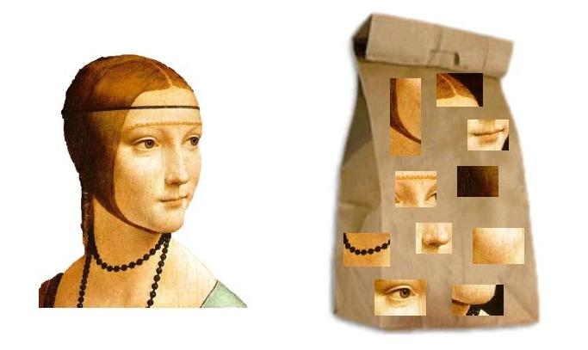
Bernhard G. Humm
Applied Artificial Intelligence
An Engineering Approach
Second Edition

Slide 2
Bernhard G. Humm
Applied Artificial Intelligence
An Engineering Approach

Slide 3
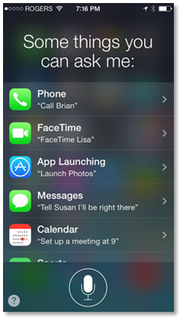

Slide 4
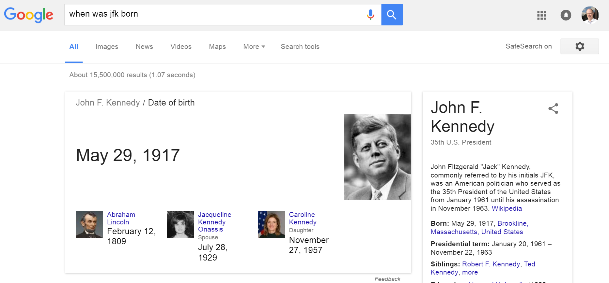

Slide 5
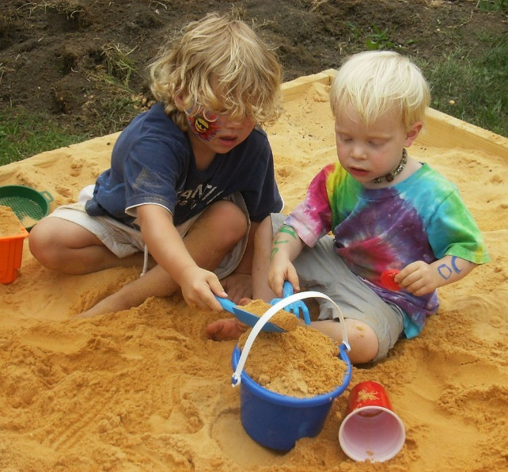
Perceiving:
Seeing, listening, feeling, …
Learning, Knowing, Reasoning: Thinking, planning, …
Communicating: Speaking, writing, …
Acting

Slide 6
Communicating
Natural language processing,
Information retrieval
Reasoning
Logic programming,
Probabilistic reasoning
Complex event processing
Applying
intelligence
Perceiving
Computer vision,
Sensor technology
Acting
Planning,
Agent technology,
Robotics
Non-symbolic
AI /
Machine
learning
Symbolic AI /
Knowledge-
based AI
Acquiring
intelligence
Semantic networks
Ontologies
Logic programming
Learning
Machine learning,
Data mining
Knowing
Knowledge representation
Artificial neural networks
Support vector machines
Linear / logistic regression
Random forest
Gradient boosting tree
K-Nearest neighors
K-means
Naive Bayes
Bayes networks
Hidden Markov models
Decision tree learning
Inductive logic programming

Slide 7
Communicating
Natural language processing,
Information retrieval
Reasoning
Logic programming,
Probabilistic reasoning
Complex event processing
Applying
intelligence
Perceiving
Computer vision,
Sensor technology
Acting
Planning,
Agent technology,
Robotics
Non-symbolic
AI /
Machine
learning
Symbolic AI /
Knowledge-
based AI
Acquiring
intelligence
Semantic networks
Ontologies
Logic programming
Learning
Machine learning,
Data mining
Knowing
Knowledge representation
Artificial neural networks
Support vector machines
Linear / logistic regression
Random forest
Gradient boosting tree
K-Nearest neighors
K-means
Naive Bayes
Bayes networks
Hidden Markov models
Decision tree learning
Inductive logic programming

Slide 8
Communicating
Natural language processing,
Information retrieval
Reasoning
Logic programming,
Probabilistic reasoning
Complex event processing
Applying
intelligence
Perceiving
Computer vision,
Sensor technology
Acting
Planning,
Agent technology,
Robotics
Non-symbolic
AI /
Machine
learning
Symbolic AI /
Knowledge-
based AI
Acquiring
intelligence
Semantic networks
Ontologies
Logic programming
Learning
Machine learning,
Data mining
Knowing
Knowledge representation
Artificial neural networks
Support vector machines
Linear / logistic regression
Random forest
Gradient boosting tree
K-Nearest neighors
K-means
Naive Bayes
Bayes networks
Hidden Markov models
Decision tree learning
Inductive logic programming

Slide 9
Communicating
Natural language processing,
Information retrieval
Reasoning
Logic programming,
Probabilistic reasoning
Complex event processing
Applying
intelligence
Perceiving
Computer vision,
Sensor technology
Acting
Planning,
Agent technology,
Robotics
Non-symbolic
AI /
Machine
learning
Symbolic AI /
Knowledge-
based AI
Acquiring
intelligence
Semantic networks
Ontologies
Logic programming
Learning
Machine learning,
Data mining
Knowing
Knowledge representation
Artificial neural networks
Support vector machines
Linear / logistic regression
Random forest
Gradient boosting tree
K-Nearest neighors
K-means
Naive Bayes
Bayes networks
Hidden Markov models
Decision tree learning
Inductive logic programming

Slide 10
Communicating
Natural language processing,
Information retrieval
Reasoning
Logic programming,
Probabilistic reasoning
Complex event processing
Applying
intelligence
Perceiving
Computer vision,
Sensor technology
Acting
Planning,
Agent technology,
Robotics
Non-symbolic
AI /
Machine
learning
Symbolic AI /
Knowledge-
based AI
Acquiring
intelligence
Semantic networks
Ontologies
Logic programming
Learning
Machine learning,
Data mining
Knowing
Knowledge representation
Artificial neural networks
Support vector machines
Linear / logistic regression
Random forest
Gradient boosting tree
K-Nearest neighors
K-means
Naive Bayes
Bayes networks
Hidden Markov models
Decision tree learning
Inductive logic programming

Slide 11
Communicating
Natural language processing,
Information retrieval
Reasoning
Logic programming,
Probabilistic reasoning
Complex event processing
Applying
intelligence
Perceiving
Computer vision,
Sensor technology
Acting
Planning,
Agent technology,
Robotics
Non-symbolic
AI /
Machine
learning
Symbolic AI /
Knowledge-
based AI
Acquiring
intelligence
Semantic networks
Ontologies
Logic programming
Learning
Machine learning,
Data mining
Knowing
Knowledge representation
Artificial neural networks
Support vector machines
Linear / logistic regression
Random forest
Gradient boosting tree
K-Nearest neighors
K-means
Naive Bayes
Bayes networks
Hidden Markov models
Decision tree learning
Inductive logic programming

Slide 12

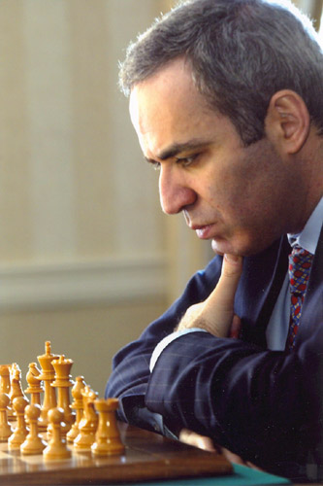

Slide 13
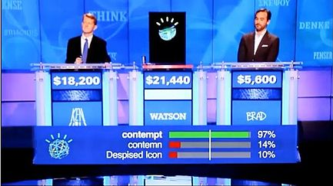

Slide 14
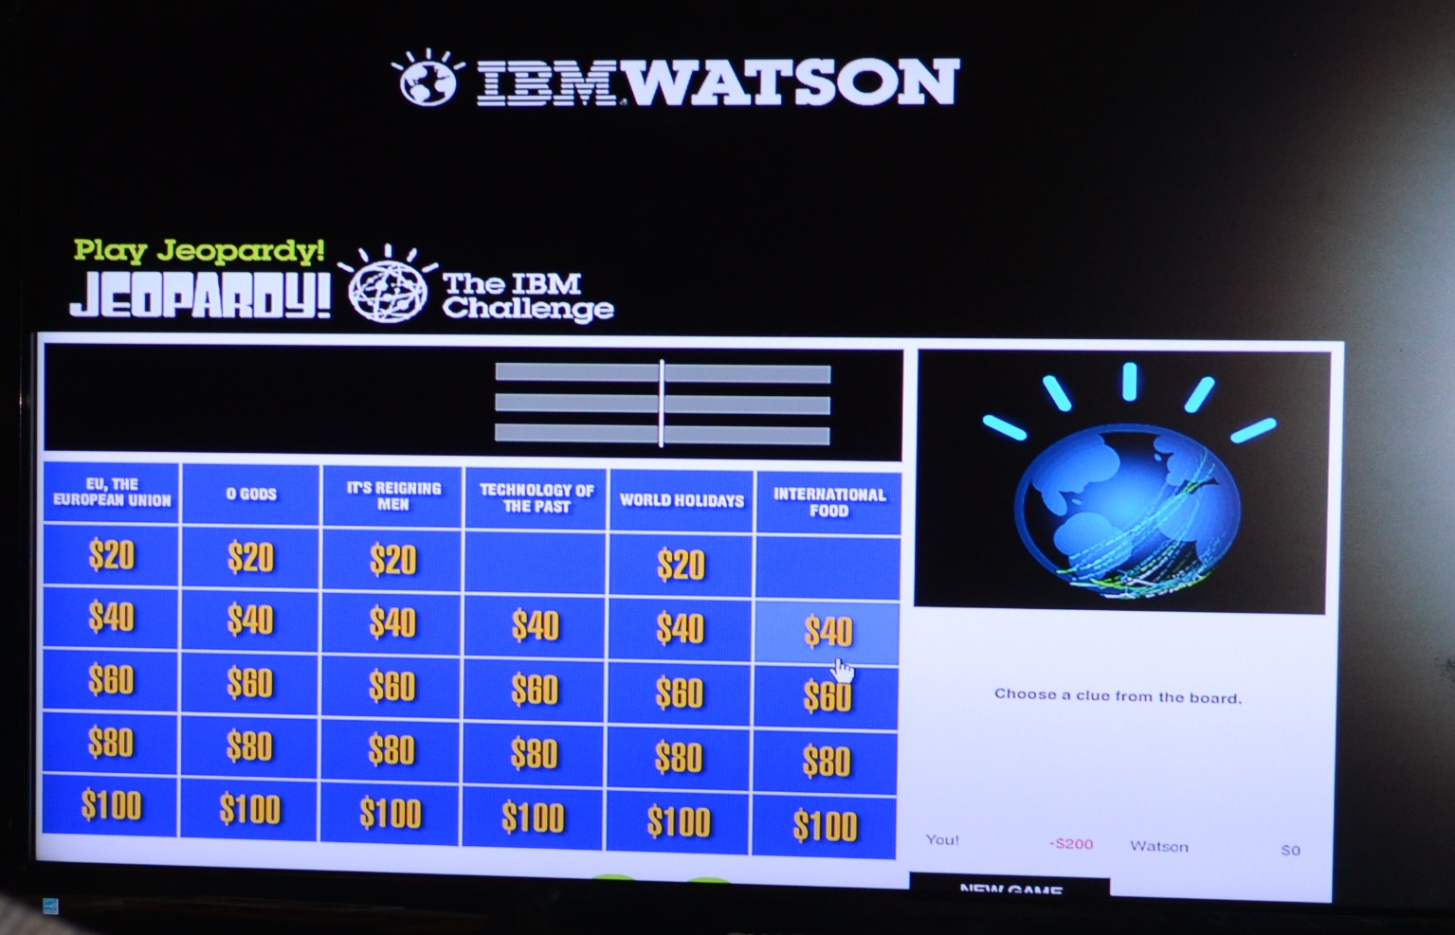

Slide 15
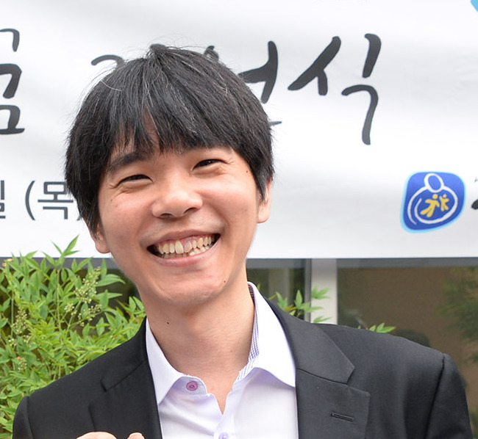
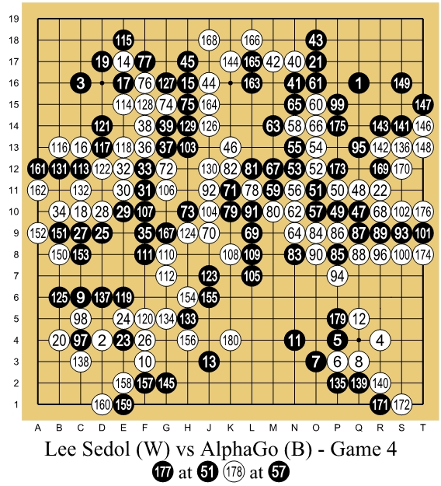
https://commons.wikimedia.org/wiki/File:Lee_Se-Dol.jpg
https://commons.wikimedia.org/wiki/File:Lee_Sedol_(B)_vs_AlphaGo_(W)_-_Game_4.jpg

Slide 16
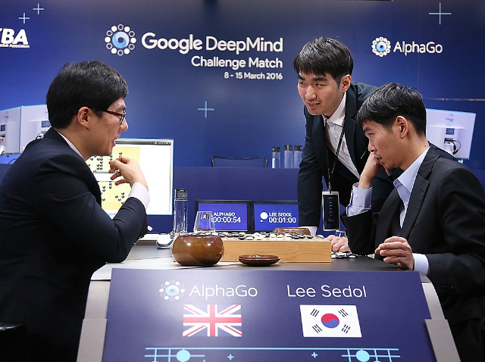

Slide 17
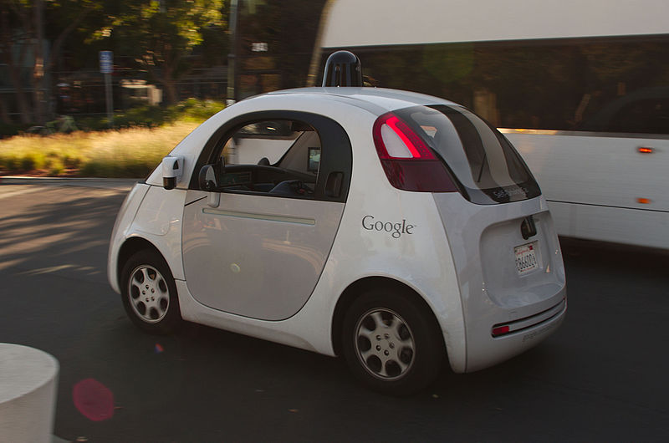

Slide 18
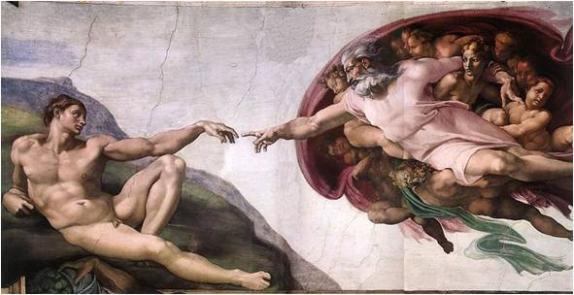

Slide 19
Michelangelo was an Italian artist.
He created many paintings, e.g., the „Creation of Adam“ in the Sistine Chapel, Rome.
He also created sculptures like David.
He belonged to the artistic movement of Renaissance.
People who create paintings are painters.
Painters are artists.

Slide 20
Ontology
Facts
Individuals
(concept instances)
Relationships
(instances)
Ontology
Ontology
Schema
Classes
(concept types)
Relationship
types
Rules

Slide 21
painted (Michelangelo, CreationOfAdam)
∀p: (∃ x: painted (p, x)) → painter (p)

Slide 22
Michelangelo
Type: Person
born: 1475
in: Italy
CreationOfAdam
type: Painting
artist:Michelangelo
…

Slide 23
Michelangelo
created
CreationOfAdam
born-in
Italy

Slide 24
(?p instance-of person)
(?p painted ?x)
-->
(?p instance-of painter)

Slide 25


Slide 27
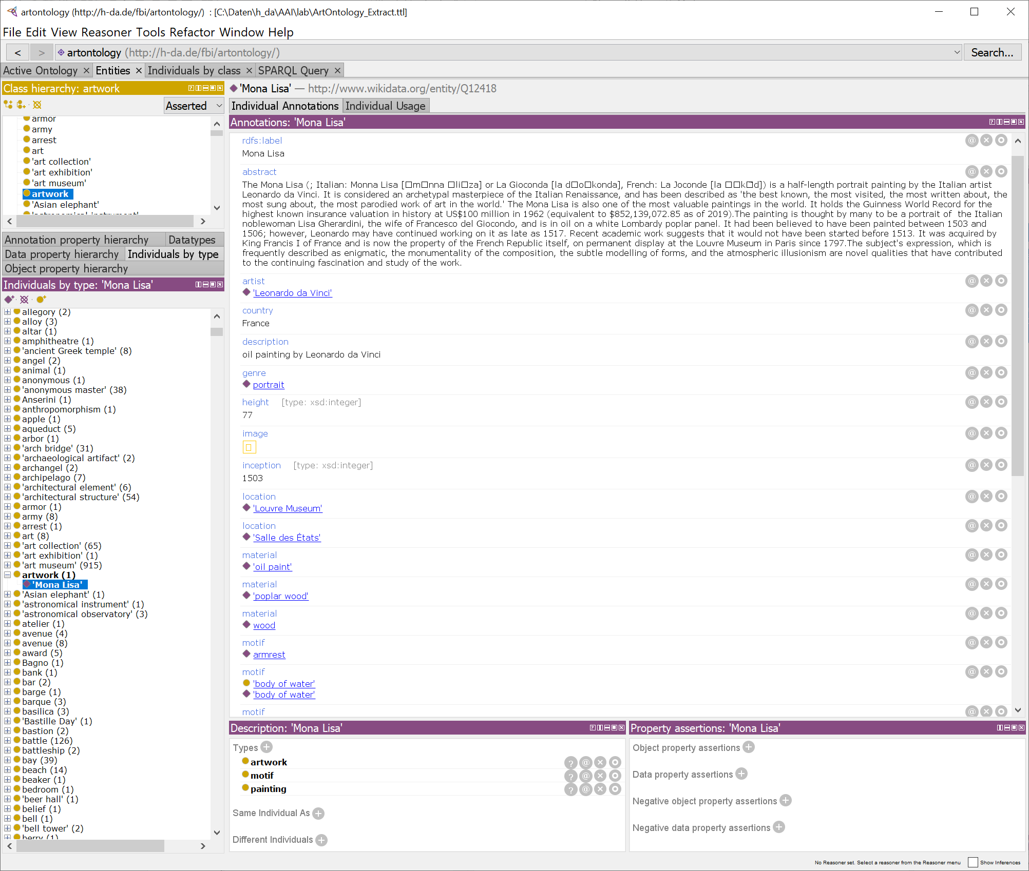

Slide 28
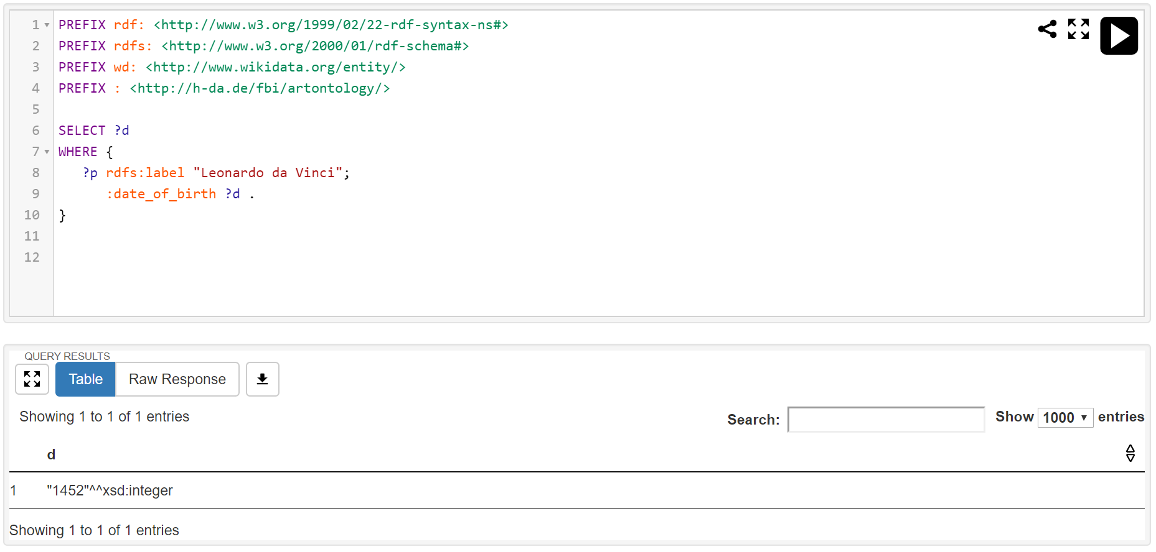

Slide 29
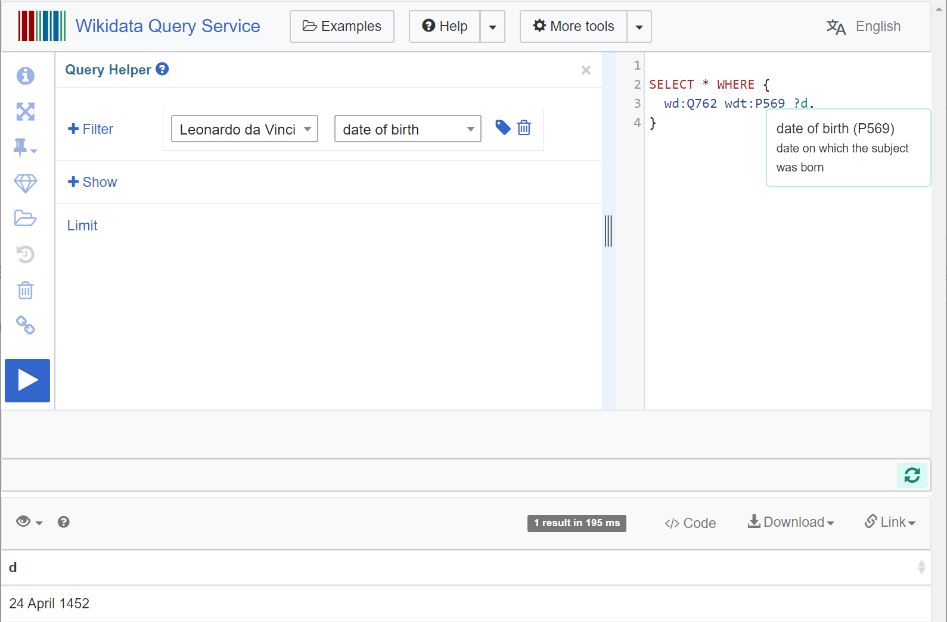

Slide 30
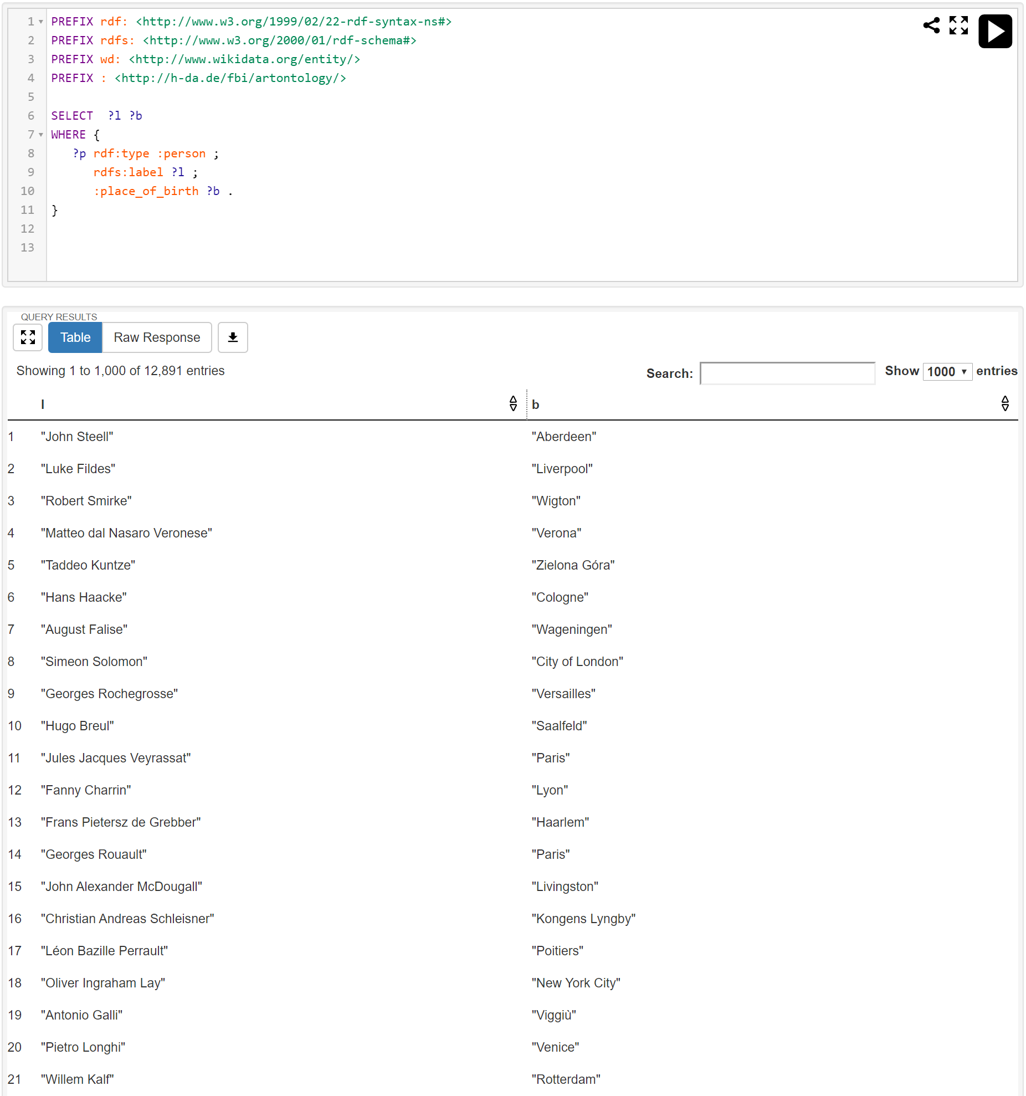

Slide 31
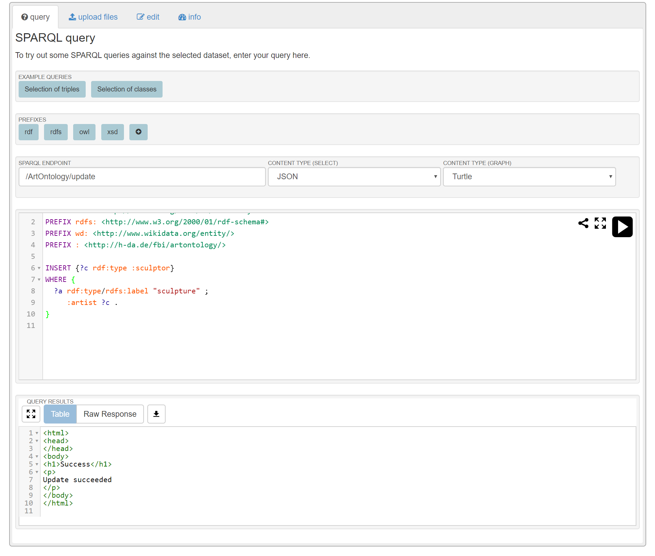

Slide 32
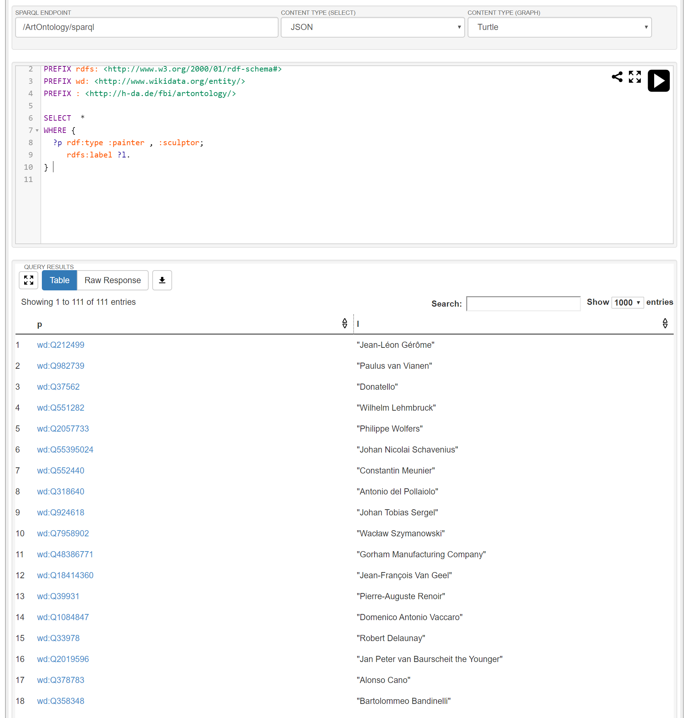

Slide 33
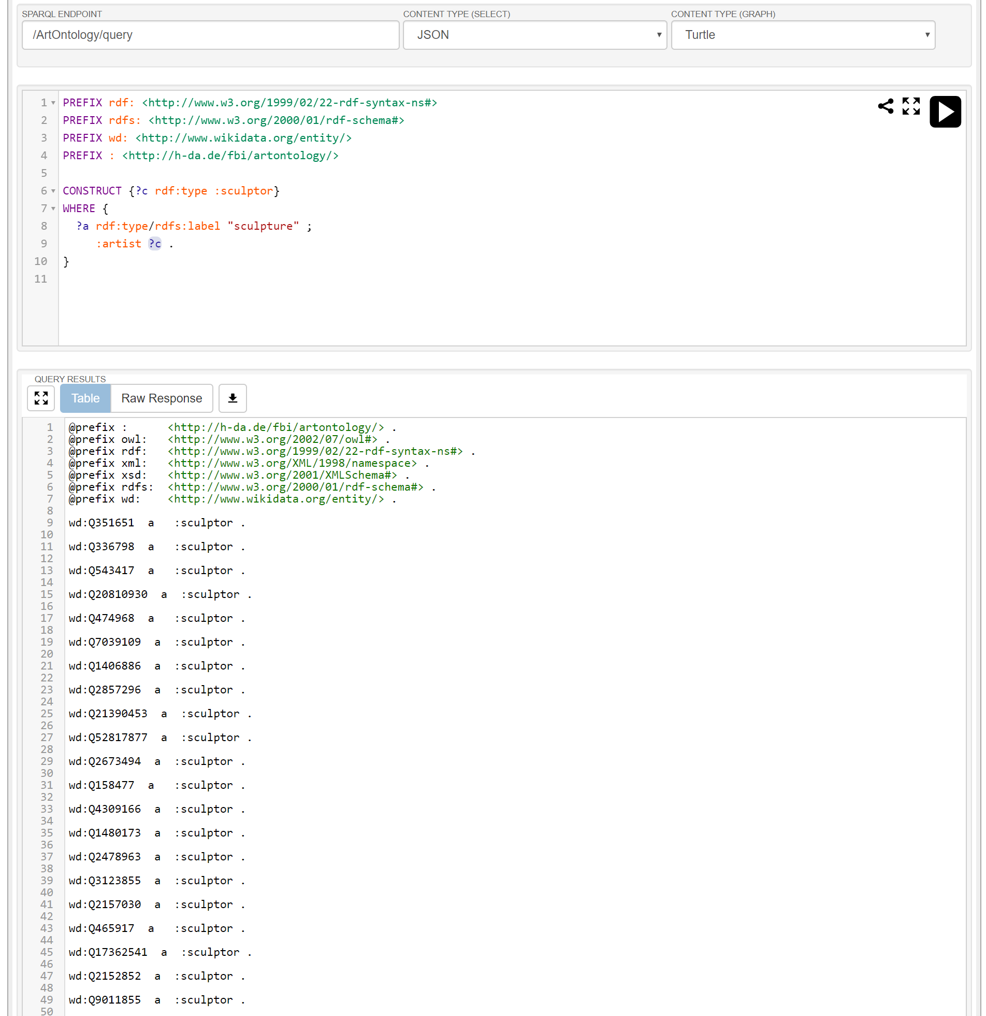

Slide 34
 | Integrated Environment | Knowledge Editor | API | Query Engine | Reasoner | Integration / Enrichment | Knowledge Base | Knowledge Resources
Protégé |  | *
Virtuoso |  |  | * | * | * |  | *
Sesame |  |  | * | * | * |  | *
Apache Jena |  |  | * | * | * |  | *
Tropbraid Suite | * | * | * | * | * | * | *
DBpedia |  |  |  |  |  |  |  | *
YAGO |  |  |  |  |  |  |  | *

Slide 35
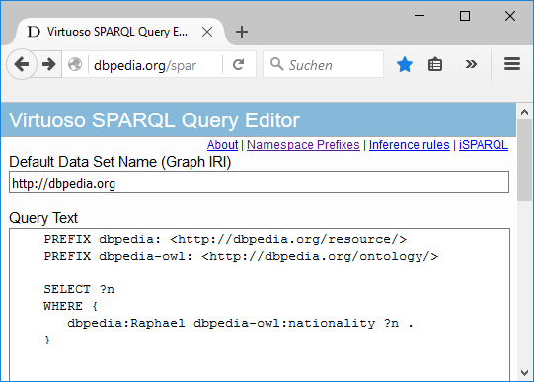
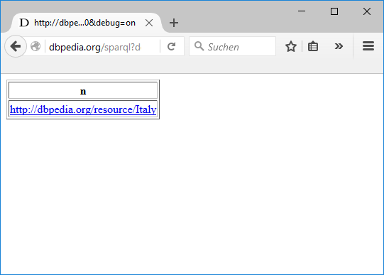

Slide 36
Namespace | Description | URI
rdf: | Resource Description Framework | http://www.w3.org/1999/02/22-rdf-syntax-ns#
rdfs: | RDF Schema | http://www.w3.org/2000/01/rdf-schema#
owl: | Web Ontology Language | http://www.w3.org/2002/07/owl#
xsd: | XML Schema | http://www.w3.org/2001/XMLSchema#
dbpedia: | Dbpedia Resource | <http://dbpedia.org/resource/>
dbpedia-owl | Dbpedia Ontology | <http://dbpedia.org/ontology/>
dbpprop | Dbpedia Property | <http://dbpedia.org/property/>
yago | YAGO Ontology | <http://dbpedia.org/class/yago/>

Slide 37
rdfs:label
"Michelangelo"
wd:Q5592
:date_of_birth
1475
…
:movement
wd:Q1474884

Slide 38
Integrated Environment
Product bundle for many knowledge representation services
KB access via programming language
Off-the-shelf ontologies
API
Knowledge Resources
Knowledge Editor
Query Engine
Reasoner
Data Integration /
Semantic Enrichment
Knowledge Base
Editing ontologies
Storing ontologies
Inferencing
Integrating knowledge resources

Slide 39












Integrated Environment
Topbraid Suite, PoolParty Semantic Suite, Semafora, …
Virtuoso, GraphDB, AllegroGraph, rdf4J, Jena, …
API
Knowledge Resources
Knowledge Editor
Query Engine
Reasoner
Data Integration /
Semantic Enrichment
Knowledge Base
Protégé, Topbraid Composer, …
Fuseki,..
Pellet, FaCT++, HermiT,..
Wikidata, Dbpedia, YAGO, CYC, GND, …

Slide 40




















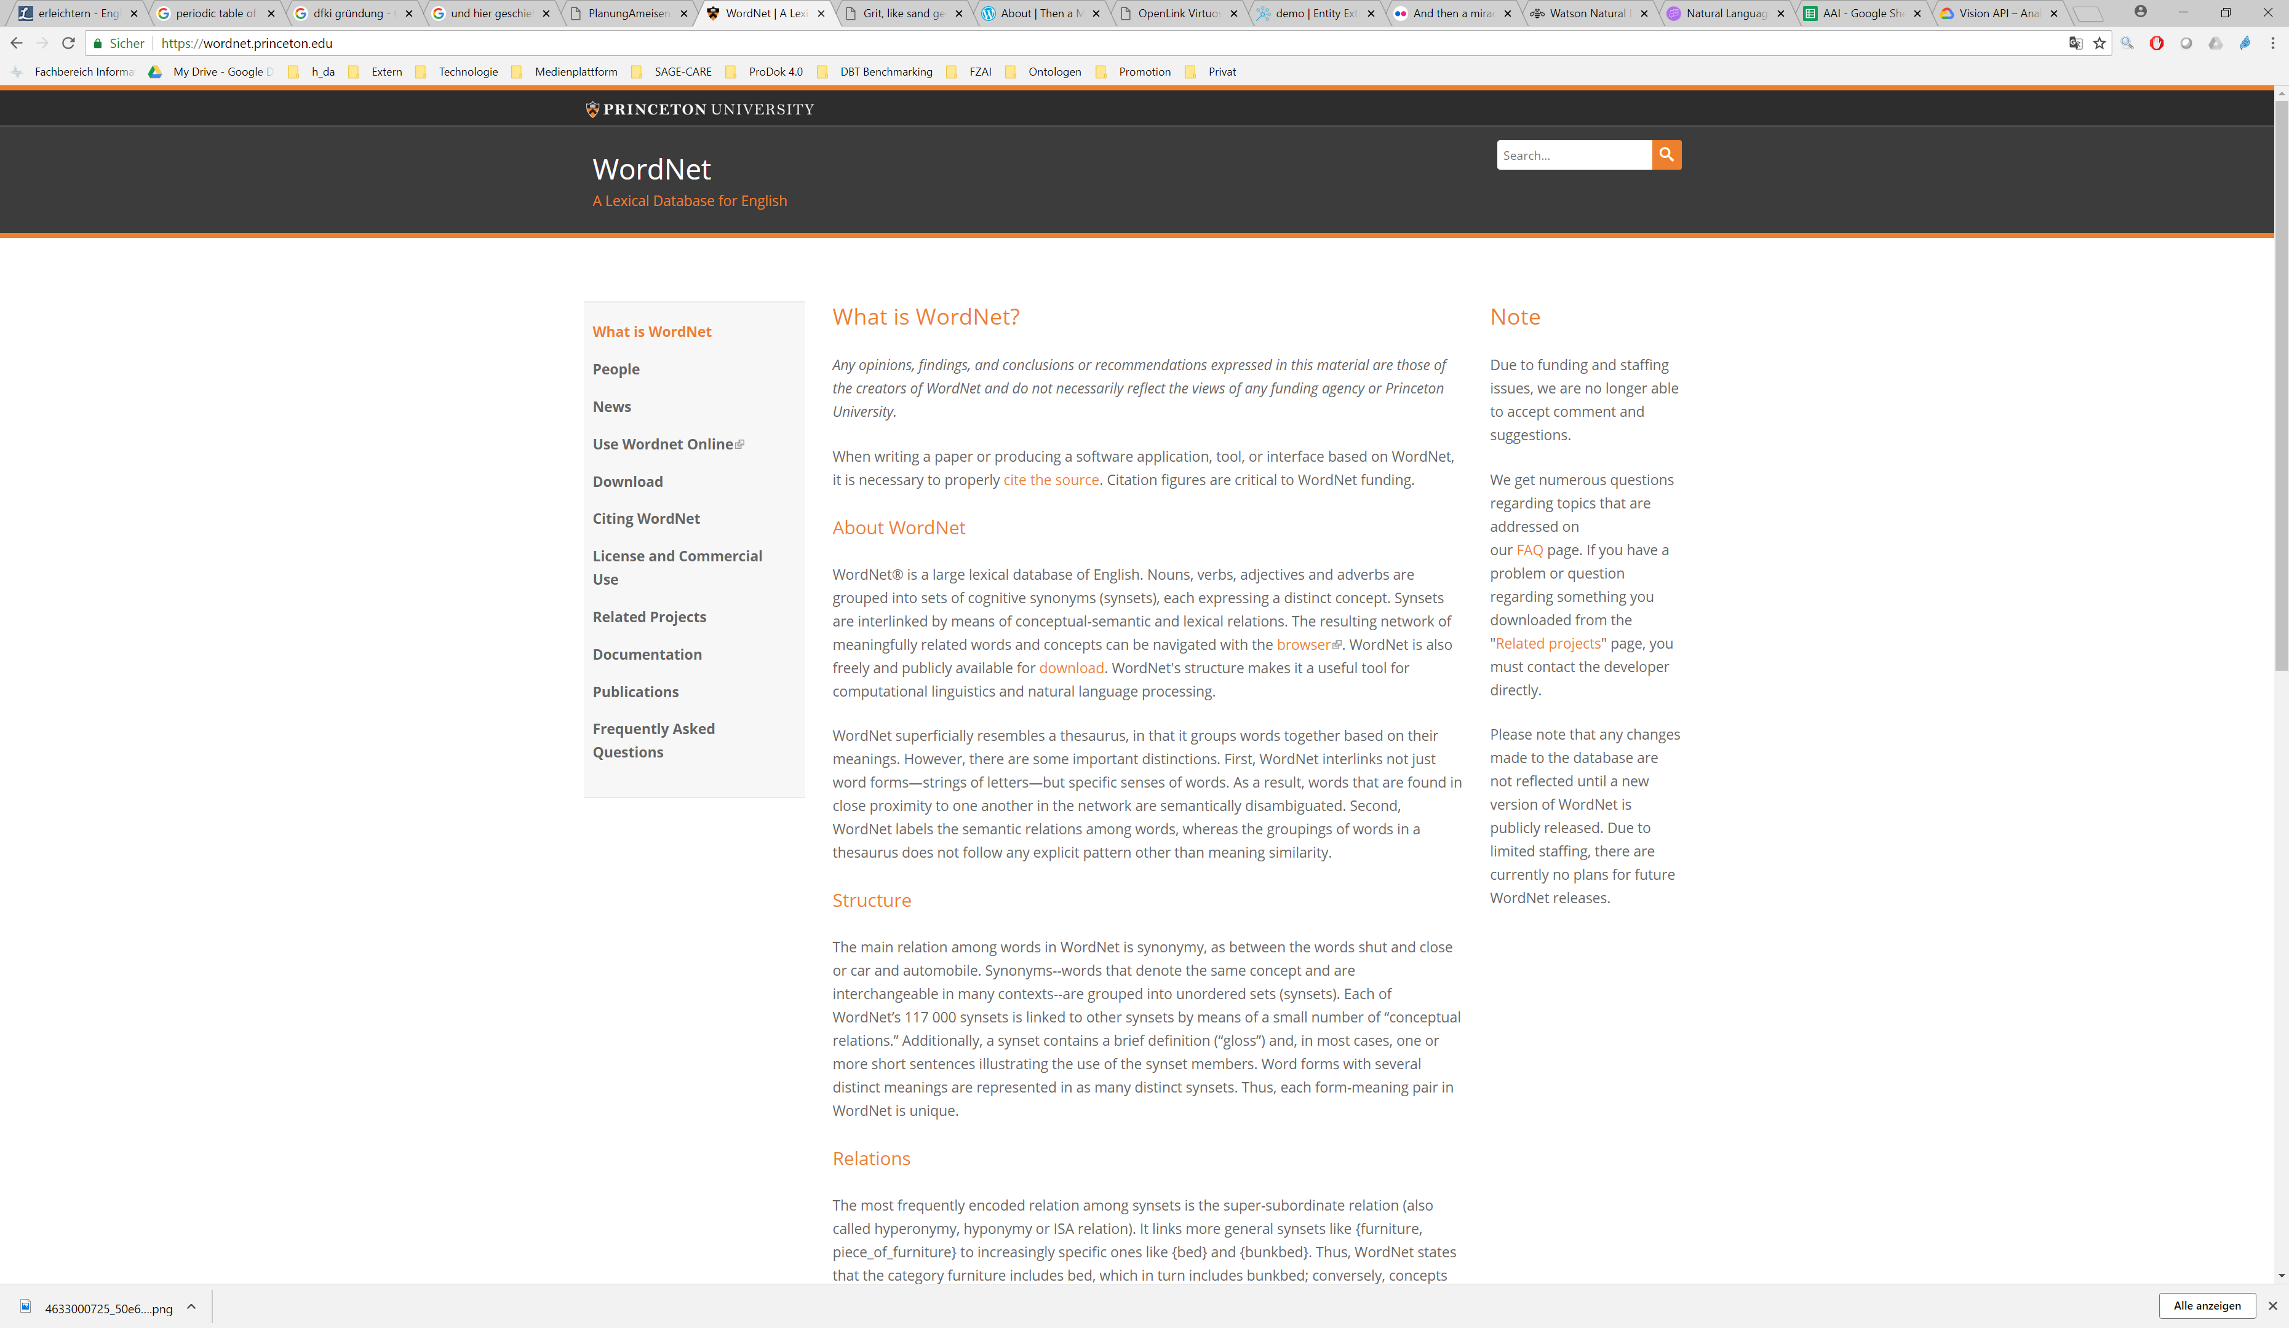
Presentation
AI Application Logic
3rd party AI web services
API
Knowledge Base / Query Engine / Reasoner
Data Integration / Semantic Enrichment
Legend:
Component
Data Flow
Ontologies, Databases, Web pages, Documents, …

Slide 41
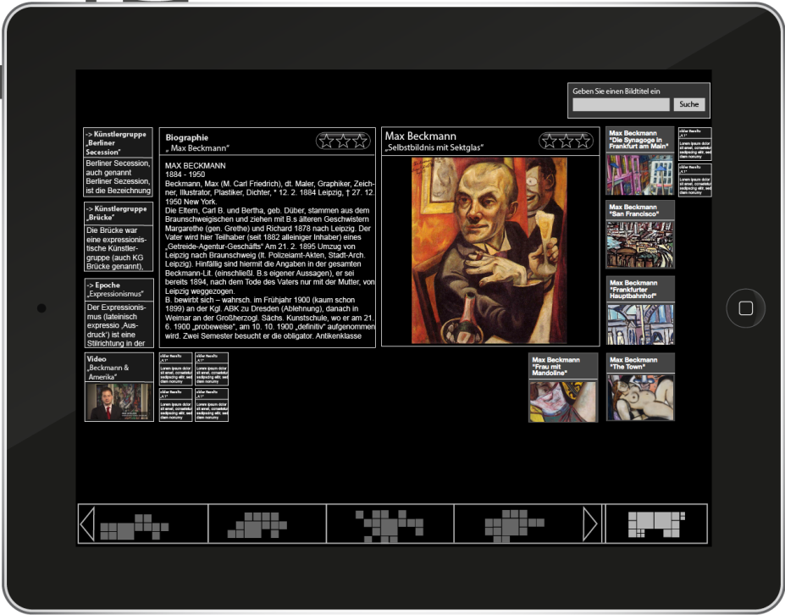
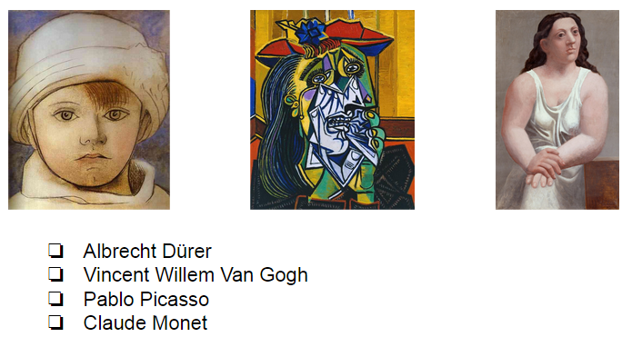

Presentation:
Virtual Museum Guide GUI
REST
API
Application Logic: Virtual Museum Guide
Online Web app
Arts
Model
User
Model
Story Gene-ration
NLP
API
Knowledge Base / Query Engine
ArtsOntology.ttl
Offline batch
Extraction Scripts
Legend:
Component
Data Flow
Wikidata

Slide 42
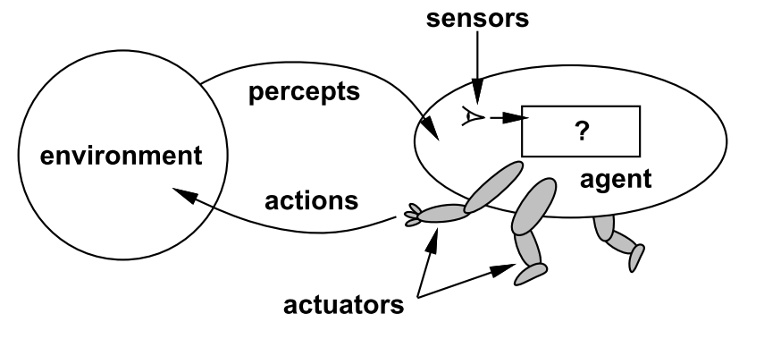

Slide 43
Agent | Environment | Percepts and Actions
Thermostat | Room and heating | Measures temperature and adjusts heating accordingly
Softbot | Internet | Crawls web pages, extracts information (e.g., compares prices), makes recommendations or even purchases autonomously
Robot | Home | Performs simple household tasks like vacuum cleaning
Human | World | Performs all sorts of things, some better, some worse for the environment ;-)

Slide 44
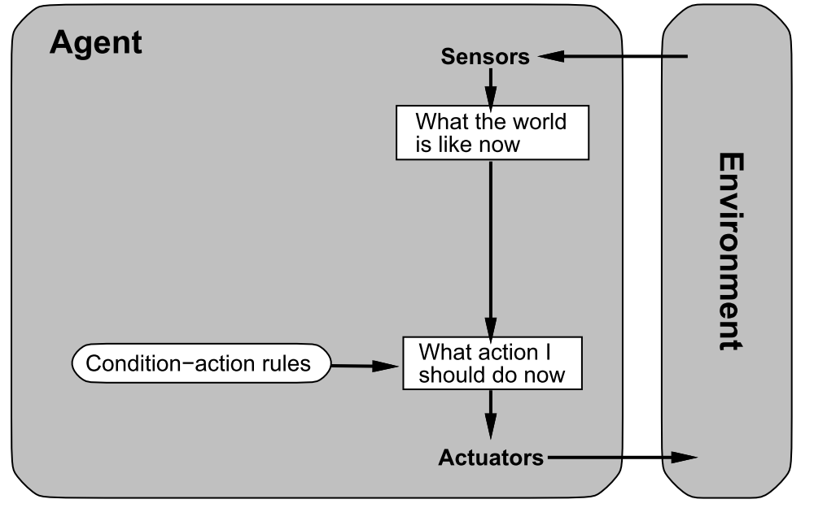

Slide 45
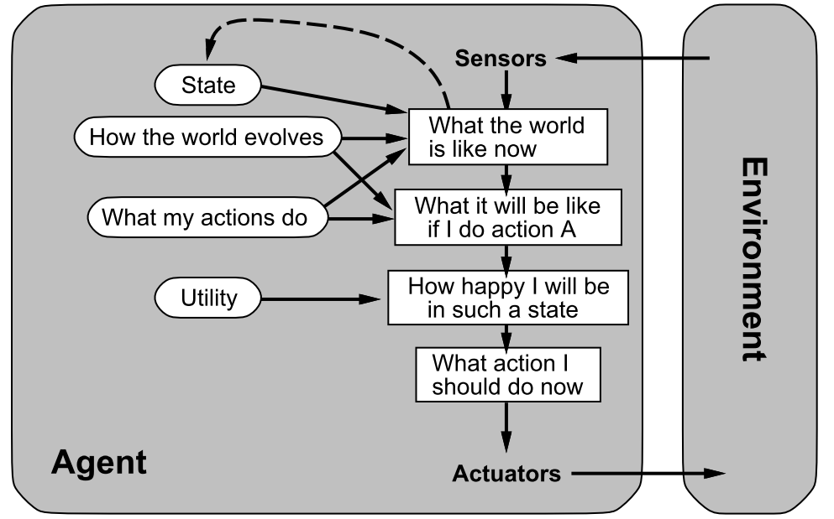

Slide 46
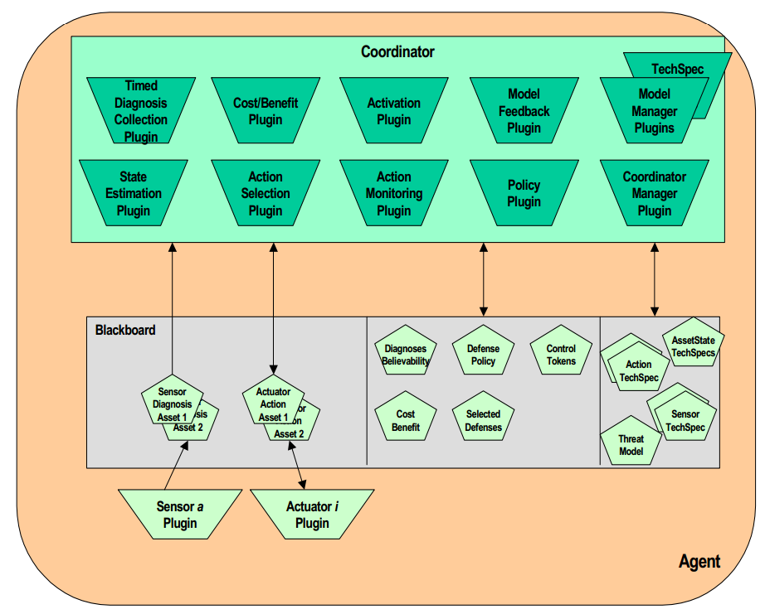

Slide 47
Search web service
Search server platform
Web service providing a complete search facility
Server platform as stand-alone search engine
Search engine library
Indexer
Crawler
Library and API for accessing a search index incl. ranking
Library and API for creating a search index
Library for crawling web pages

Slide 48






Search web service
Search server platform
Google, Yahoo, …
Solr,
Elastic Search
Search engine library
Indexer
Crawler
Lucene, …
Nutch, …

Slide 49
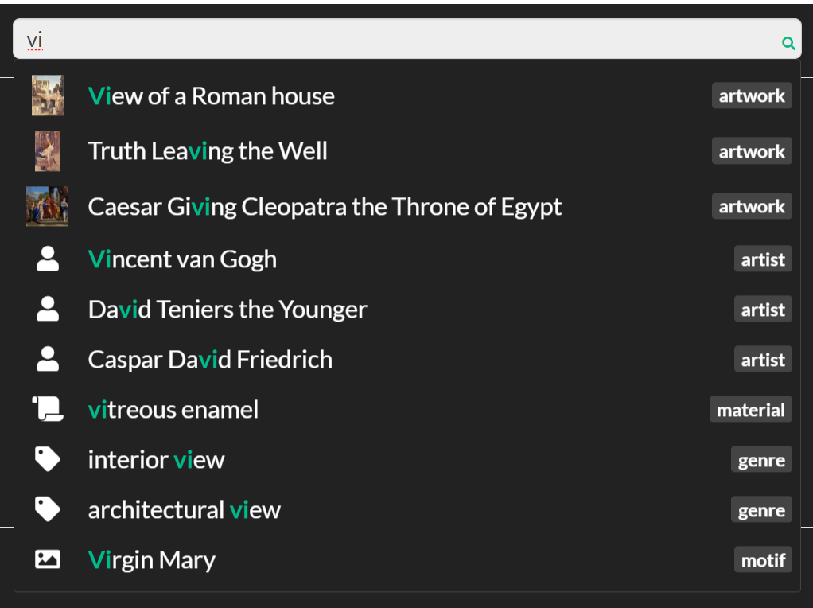

Slide 50
Information needed for processing
NLP processing step
Information level
Example
Consequences
inform (x, y)
Background knowledge
Pragmatic
analysis
Knowledge
eats (Billy, Lunch)
Background knowledge
Semantic
analysis
Sentences
Billy is eating lunch.
Grammar rules
Syntactic
analysis
Words
Billy …
Dictionaries
Lexical
analysis
Letters
Bil…
Language sound combinations
Phonological
analysis
Sounds
æ ç Þ ð ţ ş
Features of the voice
Phonetic
analysis
Acoustic
Signals

Slide 51
ID | John | likes | to | watch | movies | Mary | too | … | label
t1 | 1 | 2 | 1 | 1 | 2 | 1 | 1 | … | A
t2 | 0 | 0 | 2 | 0 | 0 | 0 | 1 | … | C
… | … | … | … | … | … | … | … | … | …
tn | 0 | 1 | 2 | 2 | 3 | 0 | 0 | … | A

Slide 52
1-gram
2-gram
ID | John | likes | to | … | John likes | likes to | to watch | … | label
t1 | 1 | 2 | 1 | … | 1 | 1 | 1 | … | A
t2 | 0 | 0 | 2 | … | 0 | 0 | 1 | … | C
… | … | … | … | … | … | … | … | … | …
tn | 0 | 1 | 2 | … | 0 | 1 | 2 | … | A

Slide 54
My
dog
also
likes
eating
sausage
.

Slide 55
My
dog
also
likes
eating
sausage
.

Slide 56
My
dog
also
likes
eating
sausage
.
PRP$
NN
RB
VBZ
VBG
NN
.
Possessive pronoun
Noun, singular
Verb, 3rd person singular present
Verb, gerund or present participle
Adverb
Noun, singular
Full stop (period)

Slide 57
sentence
ROOT
noun phrase
verb phrase
S
NP
VP
ADVP
VBZ
NP
My
dog
also
likes
eating
sausage
.
PRP$
NN
RB
VBZ
JJ
NN
.

Slide 58
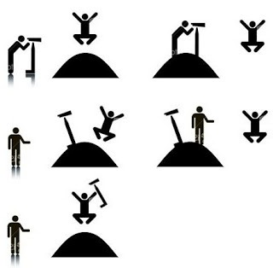
I saw the man. The man was on the hill. I was using a telescope.
I saw the man. I was on the hill. I was using a telescope.
I saw the man. The man was on the hill. The hill had a telescope.
I saw the man. I was on the hill. The hill had a telescope.
I saw the man. The man was on the hill. I saw that he was using a telescope.

Slide 59
NLP web services
NLP frameworks
Machine translation, NER, sentiment analysis, …
Frameworks for integrating NLP building blocks (pipeline-based)
NLP building blocks
Language resources
BoW model, tf-idf, n-gram, tokenizing, POS tagging, parsing, …
Language data sets: dictionaries, thesauri, synonyms, …

Slide 60








NLP web services
Google Cloud Speech API, Amazon Alexa Voice service, IBM Watson Speech to text, MS Azure speech service, …
NLP frameworks
UIMA, GATE, …
NLP building blocks
NLP resources
Stanford Tokenizer, POS Tagger, Parser, …
ML libraries: TensorFlow, scikit-learn, MLlib, …
WordNet, GermaNet, …

Slide 61
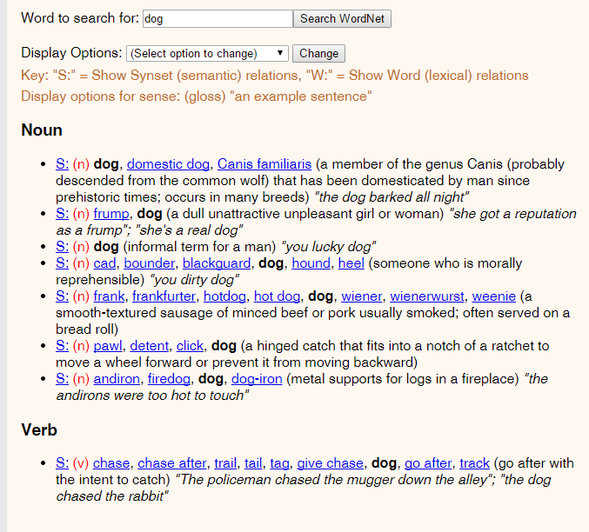

Slide 62
Animal
Broader (hypernym)
Mammal
Synonym
Dog
Canis familiaris
Narrower (hyponym)
Puppy
Hunting dog
Dalmatian
Poodle
…

Slide 63
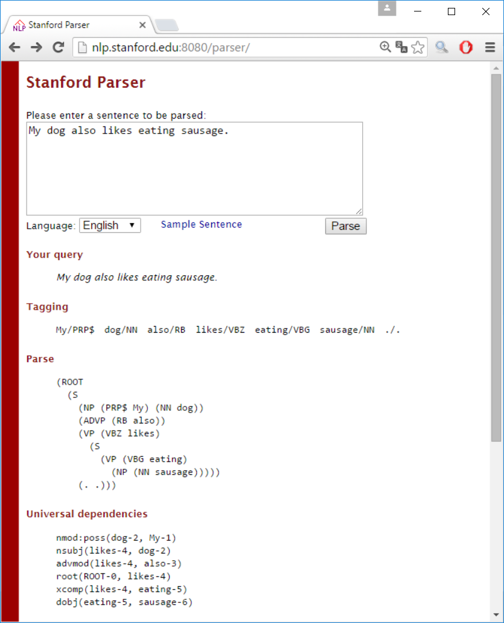

Slide 64
Specifies common data formats
Plugin architecture
Allows pipeline configuration
Perform NLP tasks
3rd party products (e.g., Stanford parser)
UIMA pipelining framework
NLP building blocks (components)
Tokenizer
Sentence Splitter
POS Tagger
Parser
…
Language
resources
Dictionary
Named Entitites
…
Provide NLP data
3rd party products (e.g., WordNet)

Slide 65


Slide 66
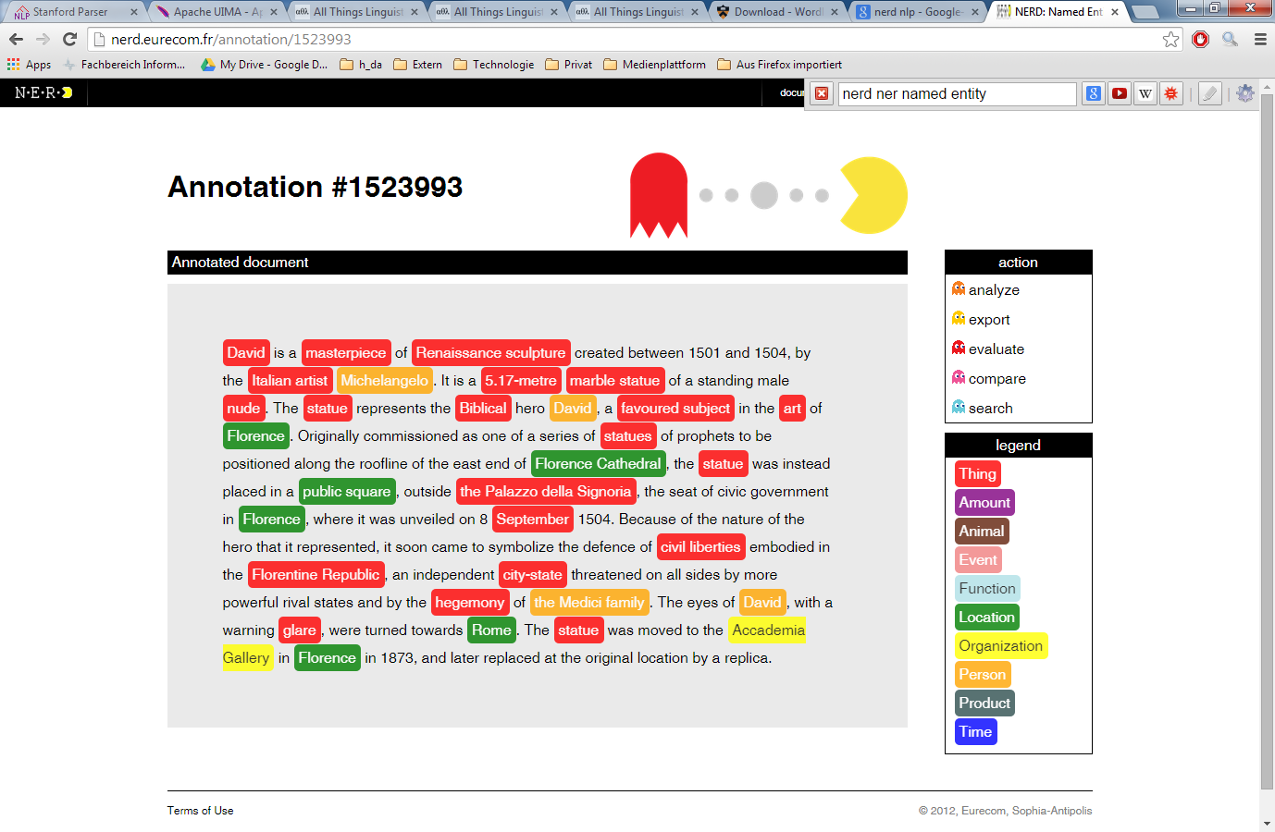

Slide 67

New emails
Automatically
classified
Not
spam
Spam filter
Spam
Training input
Corrections
Manually
classified
samples

Slide 68
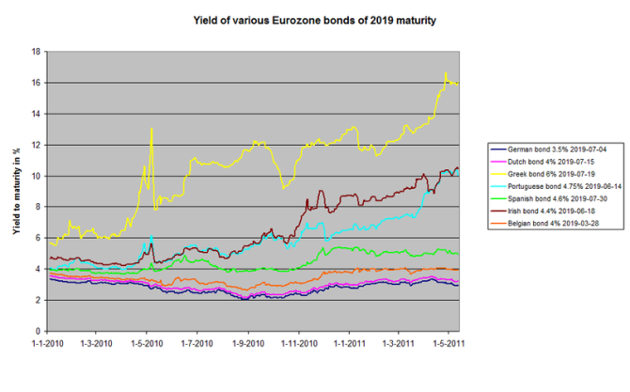

Current share values
Prediction
Recommendation
Training input
Decision
History of
share values

Slide 69
Automatically
classified
No
fraud
Fraud detection
Fraud
Training input
Corrections
Manually
classified
samples

Slide 70
Order
Recommendation
of related products
Recommender system
Training input
Purchasing behaviour
of other customers
or customer groups

Slide 71
Machine Learning
Supervised Learning
Unsupervised Learning
Reinforcement Learning
ML Area
Classifi-cation
Regression
Clustering
Feature selection / extraction
Topic modeling
ML Task

Slide 72


Slide 73
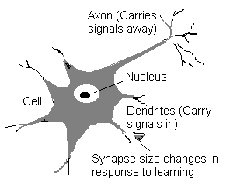

Slide 74
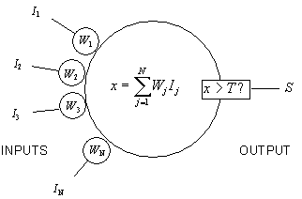

Slide 75
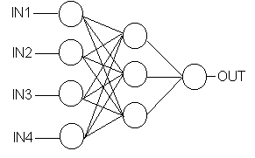

Slide 76
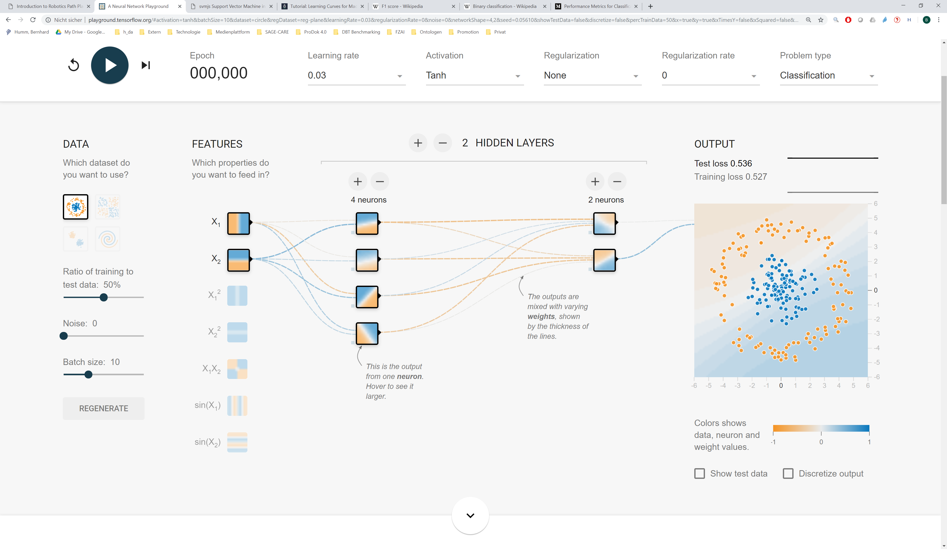
http://playground.tensorflow.org

Slide 77
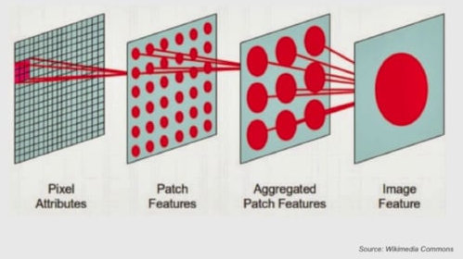

Slide 78
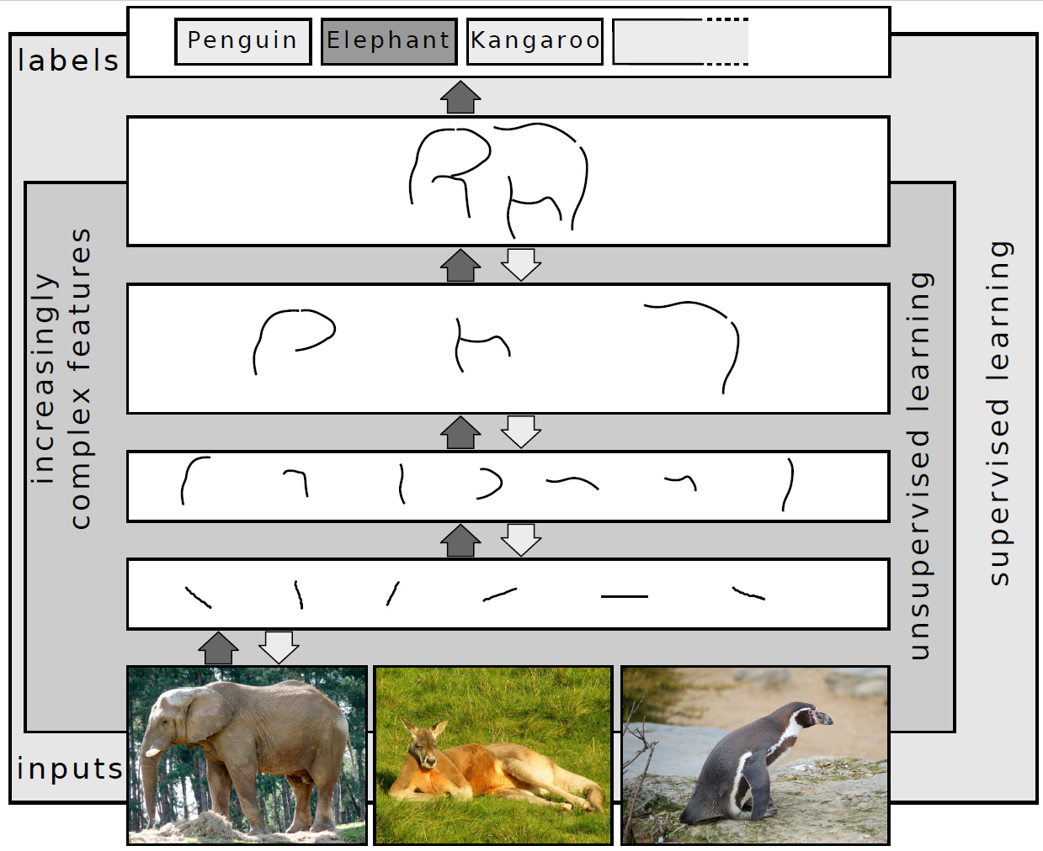

Slide 79
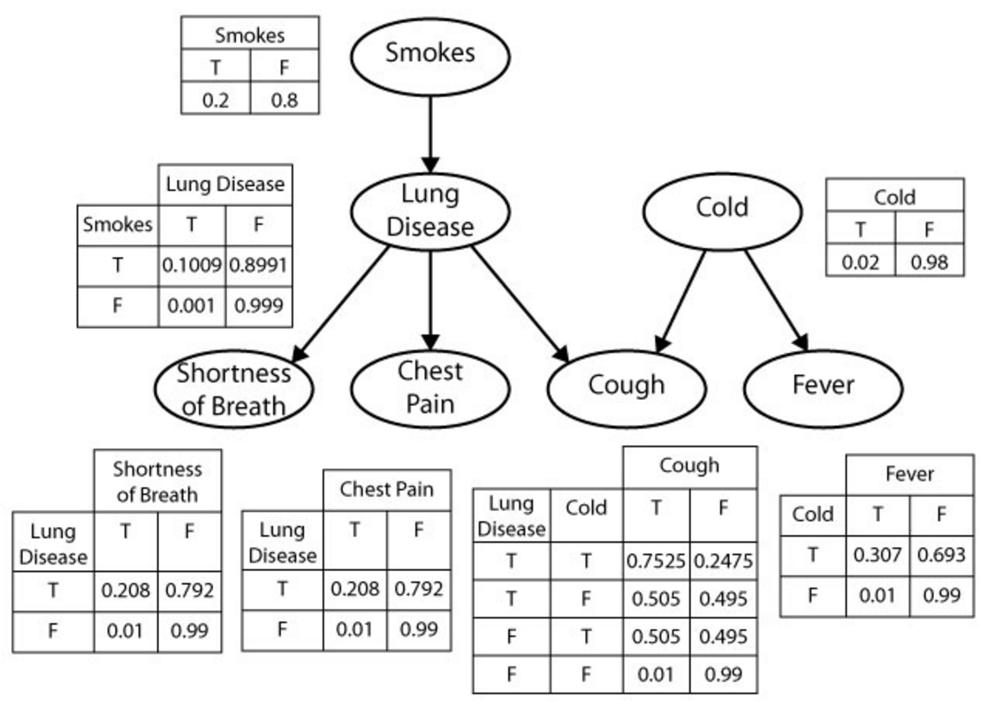

Slide 80
George
Helen
parent
Mary
Tom
Nancy
Eve

Slide 81
Classification
Regression
Artificial Neural Network (ANN)
Decision Tree
Random Forest
Gradient Boosting Tree
Logistic Regression
Linear Regression
Support Vector Machine (SVM)
Unsupervised ML Supervised ML
k-Nearest Neighbors (k-NN)
Naive Bayes
Clustering
Feature reduction
k-means Clustering
Principal Component Analysis (PCA)
Hierarchical Clustering
Singular Value Decomposition (SVD)
Canonical Correlation Analysis

Slide 82
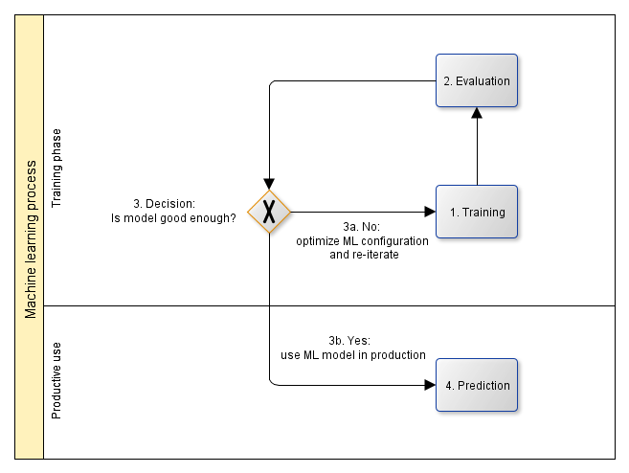

Slide 83
Evaluation
Test data set
ML application
ML result
Evaluation
ML prediction performance
Training
Split data set
Training data set
Training
ML model
Training improvement
Corrected result
Raw data set
Pre-processing
ML configuration
If model is
good enough
Prediction in productive use
Production data
ML application
ML result
Manual validation
Legend:
Data
Data Flow
Process step
Optional
process step

Slide 84
Machine learning web services
Machine learning development environments /
frameworks
Web services for experimenting with different ML approaches and configuring solutions
IDEs and frameworks for experimenting with different ML approaches and configuring solutions
Machine learning libraries
Algorithms for classification, regression, clustering, feature selection / extraction, topic modeling, etc. using different approaches, e.g., decision tree learning, artificial neural networks, Bayes networks, inductive logic programming, support vector machines, hidden Markov chains, etc.

Slide 85
Machine learning web services
Machine learning development environments /
frameworks
Google Prediction API, Microsoft Azure Machine Learning, bigml, wise.io, procog, ersatz, …
SPSS Modeler, RapidMiner, WEKA, Orange, Shogun, scikt-learn, …
Machine learning libraries
TensorFlow, DL4J, Torch, Caffeee, Theano, Eblearn, OpenNN, aisolver, CURRENNT, …

Slide 86
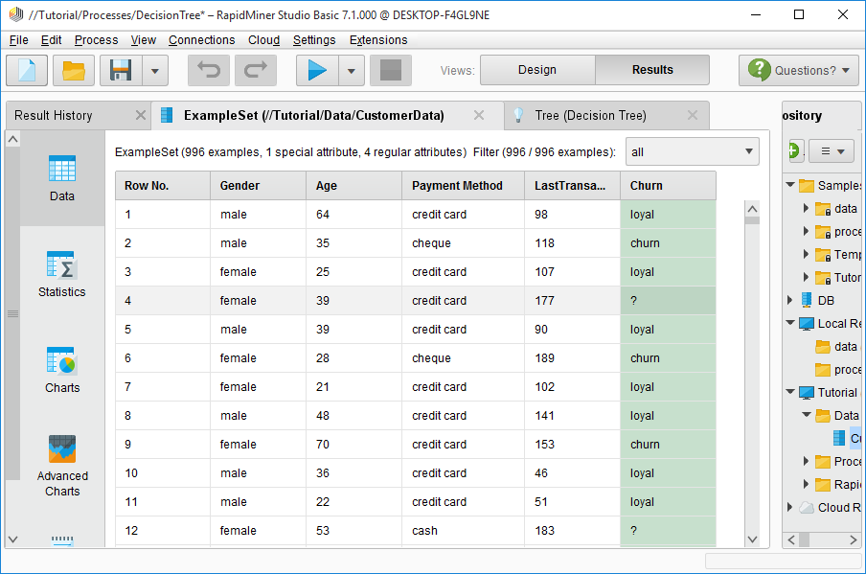

Slide 87
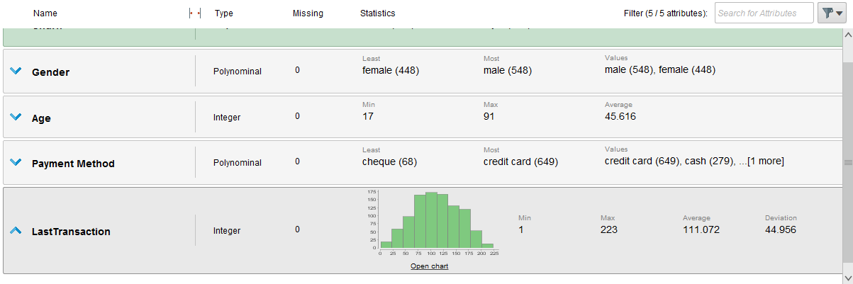

Slide 88
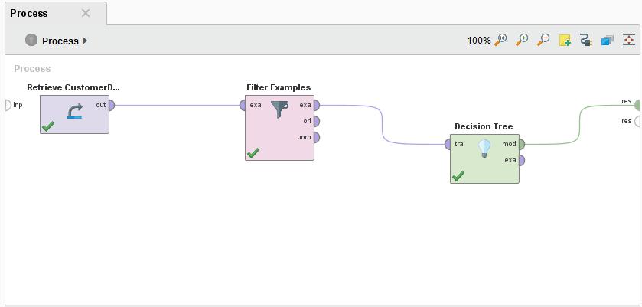

Slide 89
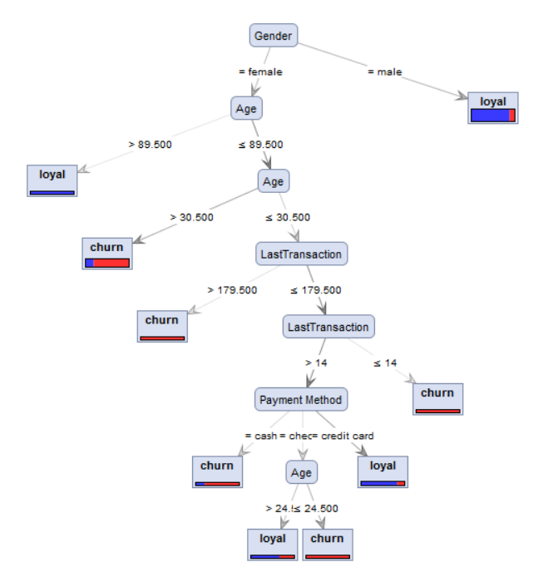

Slide 90
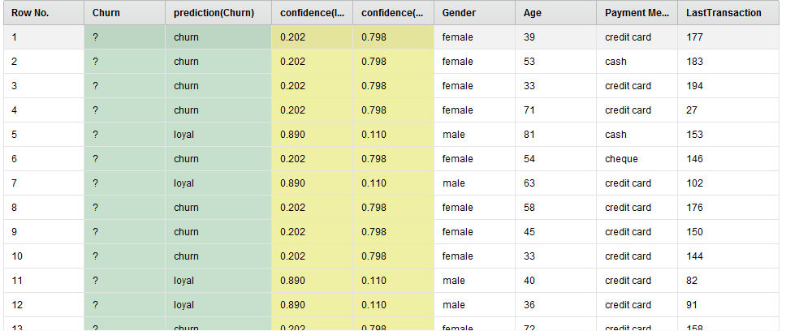

Slide 91
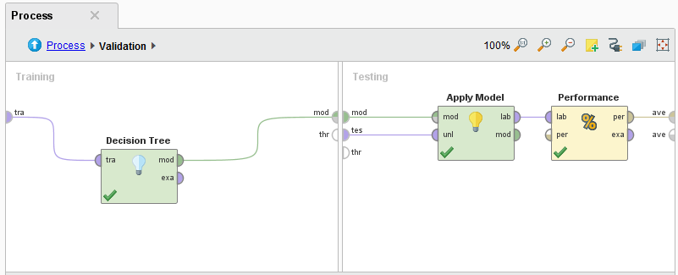

Slide 92
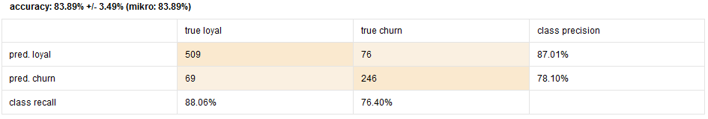

Slide 93
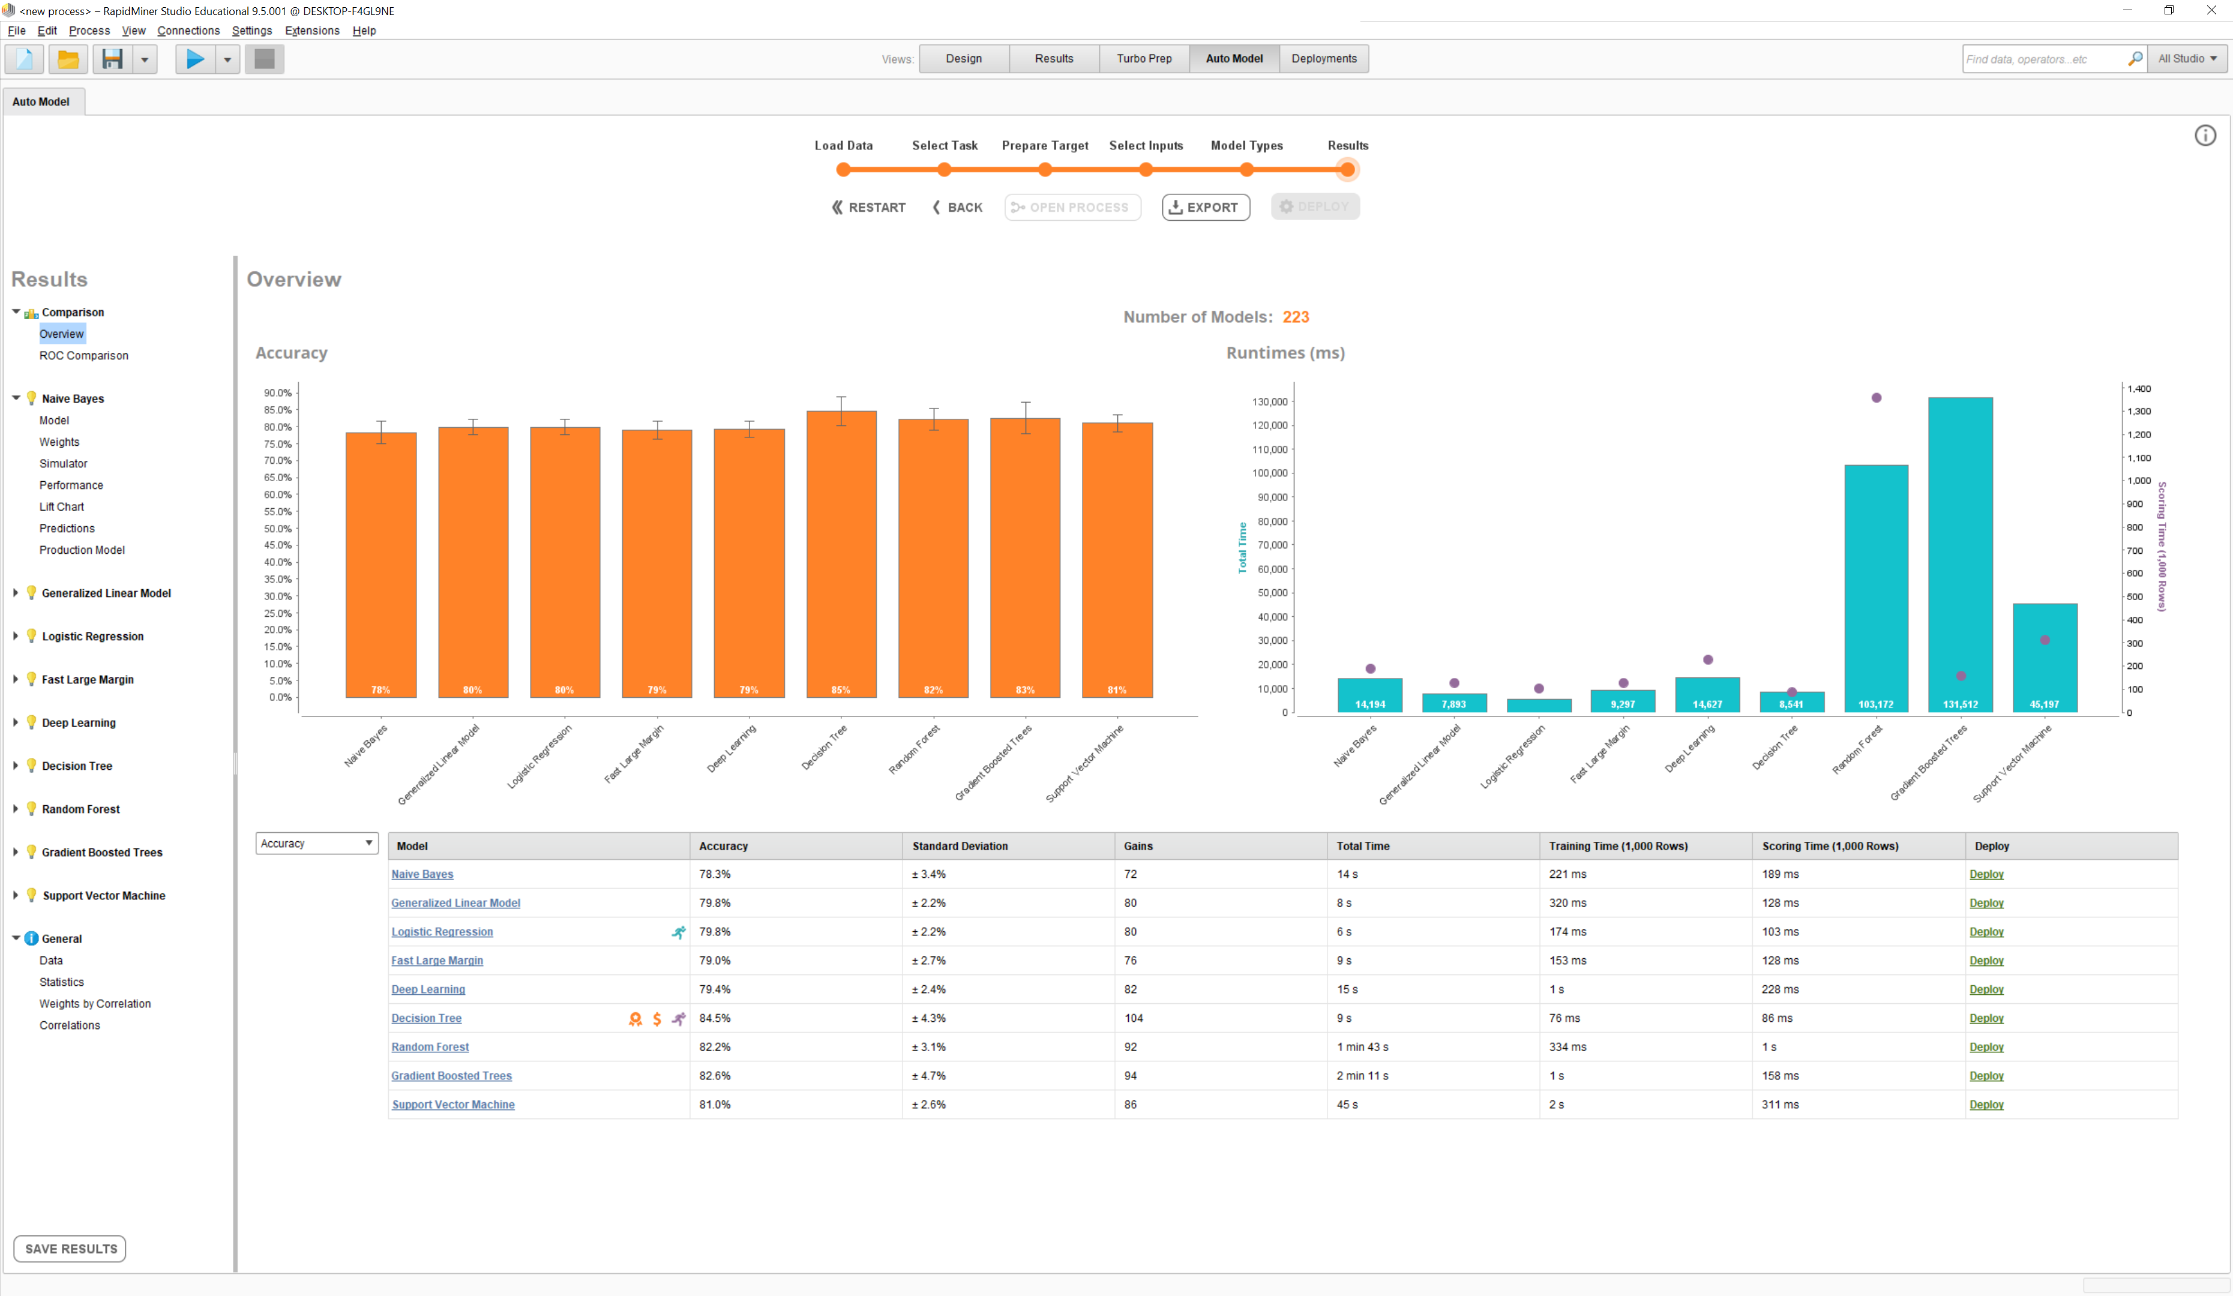

Slide 94

Actually positive
Predicted positive

Slide 95
Actual Values
Positive
(1)
Negative
(0)
Positive
(1)
True Positives (TP)
False Positives (FP)
Predicted Values
Negative
(0)
False Negatives (FN)
True Negatives (TN)

Slide 96
Actually positive
Actual Values
Positive
(1)
Negative
(0)
True Positives (TP)
False Positives (FP)
Positive
(1)
Predicted Values
Negative
(0)
False Negatives (FN)
True Negatives (TN)
Predicted positive

Slide 97
Actual Values
Malignant
Benign
Malignant
TP = 1
FP = 1
Predicted Values
Benign
FN = 8
TN = 90

Slide 98

y
x

Slide 99

k Folds
1
2
3
4
k=5
Test set
Training set
1st
→ Performance₁
2nd
→ Performance₂
k Iterations
$$Performance=\frac{1}{k} \sum_{i=1}^{k}{{Performance}_{i}}$$
3rd
→ Performance₃
4th
→ Performance₄
k=5th
→ Performance_{k}

Slide 100
y
x

Slide 101
y
x

Slide 102
y
x

Slide 103
y
x

Slide 104
y
y
y
y
x
x
x
x

Slide 105
y
x

Slide 106
y
y
y
x
x
x
(a)
(b)
(c)

Slide 107
Underfitting Optimal model complexity Overfitting
low Bias, variance, error high
low Model complexity high

Slide 108



Underfitting Optimal model complexity Overfitting
low Bias², variance, error high
Bias²
Variance
Error
low Model complexity high

Slide 109
low (good) Error high (bad)
low Training set size high

Slide 110
low (good) Error high (bad)
low Training set size high

Slide 111
The curves have already converged →
No need for adding more training instances
low (good) Error high (bad)
low Training set size high

Slide 112
The test curve could further converge to the training curve
→ Add more training instances
low (good) Error high (bad)
low Training set size high

Slide 113
Test set error
low (good) Error high (bad)
low (good) Error high (bad)
Training set error
low Training set size high
low Training set size high
(a) (b)

Slide 114
The test curve could further converge to the training curve
→ Add more training instances
The curves have already converged →
No need for adding more training instances
Test set error
Test set error
low (good) Error high (bad)
low (good) Error high (bad)
Training set error
Training set error
low Training set size high
low Training set size high
(a) (b)

Slide 115
1
Training set performance
(bad) Accuracy (good)
Test set performance
0
low Training set size high

Slide 116
Model complexity
High
(Overfitting)
Low
(Underfitting)
Number of features (attributes)
Low
High
Number of ANN layers
Low
High
Artificial
Neural Networks
Number of neurons per ANN layer
Low
High
Maximum tree size
Low
High
Decision Trees /
Random Forest
Number of branches
Low
High

Slide 117

Correct
(in reality)
Predicted
(by machine learning)
✖
✖
True negative (correctly not predicted)
False negative (correct but not predicted)
True positive (correctly predicted)
False positive (predicted but not correct)

Slide 118


Slide 119


Slide 120


Slide 121




Identify relevant services
Identify product candidates
Select product(s)
Integrate product(s)

Slide 122
ML web services
Pre-trained ML models
ML development environments
ML APIs
ML libraries

Slide 123




ML web services
ML pre-trained models
ML development environments
ML APIs
ML libraries

Slide 124



Product | Pros | Cons
Product A | … | …
Product B | … | …
Product C | … | …

Slide 125
Web services for experimenting with different ML approaches and configuring solutions
ML web services
Pre-trained ML models
IDEs for experimenting with different ML approaches and configuring solutions
Pre-trained ML models that can be fine-tuned for new applications
ML development environments
APIs for interfacing with various ML libraries
ML APIs
ML libraries
Algorithms for classification, regression, clustering, feature selection / extraction, topic modeling, etc. using different approaches, e.g., decision tree learning, Artificial Neural Networks, Bayes networks, Support Vector machines, Hidden Markov Chains, etc.

Slide 126
Amazon AWS ML, Google Cloud ML, IBM Watson ML, Microsoft Azure ML Studio, …
ML web services
ML pre-trained models
SPSS Modeler, RapidMiner, WEKA, …
ML development environments
KERAS
ML APIs
Provided via KERAS
ML libraries
TensorFlow, scikit-learn, MLlib, CNTK, Theano, …

Slide 127







Analyze use case
Identify ML tasks
Analyze data carefully
Select ML approach and product(s)
Implement iteratively
Use

Slide 128
Machine Learning
Supervised Learning
Unsupervised Learning
Reinforcement Learning
Classifi-cation
Regression
Clustering
Feature selection / extraction
Topic modeling

Slide 129


ActivityBias
Data Bias
Data
2nd order Bias
Samp-ling Bias
ML Application
Algo-rithmicBias
Training
Inter-action Bias
Prediction

Slide 130

Input:
Image of handwritten or typewritten text
Output:
Text document

Slide 131


Slide 132

Input:
Image
Output:
Information whether the image detects faces, where (position), and / or which people

Slide 133


Slide 134


Slide 135


Slide 136


Slide 137


Slide 138


Slide 139
Web services for for image search, entity recognition, etc.
CV web services
CV pre-trained models
IDEs for experimenting with different CV approaches and configuring solutions
CV/ML development environments
Pre-trained models for transfer learning
APIs for interfacing with various ML libraries
CV/ML APIs
Algorithms for CV preprocessing and for ML in general, e.g., Artificial Neural Networks etc.
CV/ML libraries

Slide 140

Amazon Rekognition, Google Cloud Vision API, IBM Watson Visual Recognition, Microsoft Azure Computer Vision, …
CV web services
CV pre-trained models
RapidMiner, WEKA, …
CV/ML development environments
KERAS
CV/ML APIs
Provided via KERAS
TensorFlow, openCV, scikit-learn, …
CV/ML libraries

Slide 141


Slide 142


Slide 143


Slide 144

Input
Feature learning
Classification
Output

Slide 145


Slide 146


Slide 147


Slide 148


Slide 149


Slide 150


Slide 151


Slide 152
DBMS Query execution: volatile
CEP rule: persistent
DBMS Data: persistent
Streaming Data: flowing
(a) (b)

Slide 153
CEP rule specification and execution; monitoring of CEP
CEP engine
Message-oriented middleware (queuing technology), including admin consoles
Message broker

Slide 154








Apache Flink, MS Azure Stream Analytics, Drools Fusion, Oracle Stream Analytics, SAG Apama, …
CEP engine
Message broker
Apache Kafka, IBM MQ, TIBCO, WebSphere Business Events, WSO2 Stream Processor, …

Slide 155


Slide 156


Slide 157


Slide 158


Slide 159


